Slide 1
Django - Extending Base Templates
AMI PATEL

Slide 2
Contents
Creating a base template
Making the links work
Adding a footer section
Serving static files

Slide 3
Creating a base template
We currently have our movies page, mailing list signup page, and news page. However, users have to manually enter in the URL to navigate to each of the pages, which is not ideal. Let's add a header bar that allows them to navigate between pages. We will begin with movie/templates/home.html:
We will use as a base the markup of the Navbar component from getbootstrap (https://getbootstrap.com/docs/5.1/components/navbar/ ).
We also include the bootstrap.bundle.min.js script inside the <head> tag.

Slide 4
movie/templates/home.html
<!DOCTYPE html>
<html>
<head>
…
<script src="https://cdn.jsdelivr.net/npm/
bootstrap@5.1.1/dist/js/bootstrap.bundle.min.js"
crossorigin="anonymous">
</script>
<meta name="viewport" content="width=device-width,
initial-scale=1" />
</head>

Slide 5
movie/templates/home.html
<body>
<nav class="navbar navbar-expand-lg navbar-light
bg-light mb-3">
<div class="container">
<a class="navbar-brand" href="#">Movies</a>
<button class="navbar-toggler" type="button"
data-bs-toggle="collapse"
data-bs-target="#navbarNavAltMarkup"
aria-controls="navbarNavAltMarkup"
aria-expanded="false"
aria-label="Toggle navigation">
<span class="navbar-toggler-icon"></span>
</button>
<div class="collapse navbar-collapse"
id="navbarNavAltMarkup">
<div class="navbar-nav ms-auto">
<a class="nav-link" href="#">News</a>
<a class="nav-link" href="#">Login</a>
<a class="nav-link" href="#">Sign Up</a>
</div>
</div>
</div>
</nav>
<div class="container">
…

Slide 6
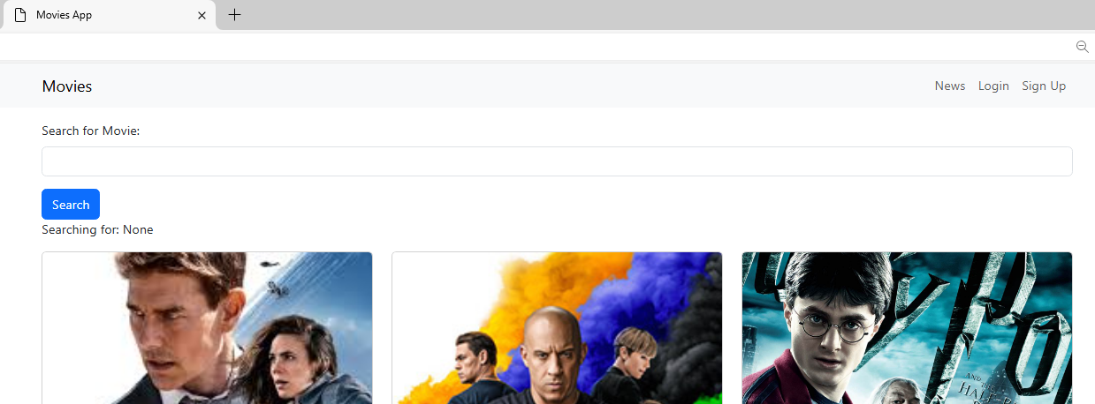
We also included two links (Login and Sign Up), which will be used later.

Slide 7
But should we repeat the same process and copy the exact same code into news.html and other future pages?
This would duplicate a lot of the same code. Worse, it will be very hard to maintain the code. Suppose we want to add a new link – we would have to add the link on multiple pages!
To fix this, we will be using base templates, where we can add the navbar to every single page. This allows us to make changes to our navbar in a single place, and it will apply to every page.
Since this will be a "global" template (which will be used across all pages and apps), we will add it to the main folder (moviereviews). In the moviereviews folder, create a folder called templates. In that folder, create a file, base.html.

Slide 8
moviereviews/templates/base.html
<html>
<head>
<title>Movies App</title>
<link href="https://cdn.jsdelivr.net/npm/
bootstrap@5.1.1/dist/css/bootstrap.min.css"
rel="stylesheet" crossorigin="anonymous" />
<script src="https://cdn.jsdelivr.net/npm/
bootstrap@5.1.1/dist/js/bootstrap.bundle.min.js"
crossorigin="anonymous">
</script>
<meta name="viewport" content="width=device-width,
initial-scale=1" />
</head>
<body>
<nav class="navbar navbar-expand-lg
navbar-light bg-light mb-3">
<div class="container">
<a class="navbar-brand" href="#">Movies</a>
<button class="navbar-toggler" type="button"
data-bs-toggle="collapse"
data-bs-target="#navbarNavAltMarkup"
aria-controls="navbarNavAltMarkup"
aria-expanded="false"
aria-label="Toggle navigation">
<span class="navbar-toggler-icon"></span>
</button>
<div class="collapse navbar-collapse"
id="navbarNavAltMarkup">
<div class="navbar-nav ms-auto">

Slide 9
<a class="nav-link" href="#">News</a>
<a class="nav-link" href="#">Login</a>
<a class="nav-link" href="#">Sign Up</a>
</div>
</div>
</div>
</nav>
<div class="container">
{% block content %}
{% endblock content %}
</div>
</body>
</html>

Slide 10
base.html, as its name suggests, serves as the base for all pages. Thus, we include
the header navbar in it. We will later include a footer section.
We then allocate a block where content can be slotted in from other child pages –
for example, home.html and news.html:
{% block content %}
{% endblock content %}

Slide 11
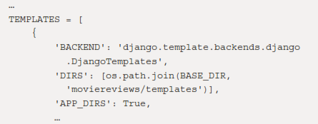
register the moviereviews/templates folder in our application settings. Make sure to add it to TEMPLATES DIRS in /moviereviews/settings.py:

Slide 12
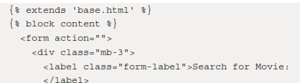
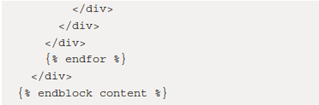
In movie/templates/home.html, we shouldn't have the header and navbar anymore. To simplify things, let's remove the sign-up mailing list form. Also, remove the <div class="container"> tag, since it is loaded in the base.html template. The entire movie/templates/home.html will look something like this:

Slide 13
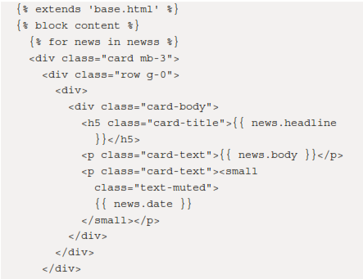

apply the preceding to news.html as well. Replace all existing content of /news/template/news.html

Slide 14
http://localhost:8000/news/
News page extending the base.html template
Now, whenever you want to make a change to the navbar, you just have to do it once in base.html, and it will apply to all the pages!

Slide 15
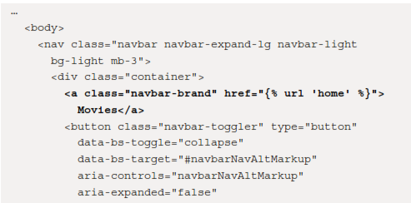
Making the links work
The links in the navbar don't currently work. To enable them, in moviereviews/templates/base.html, add the following code in bold:

Slide 16
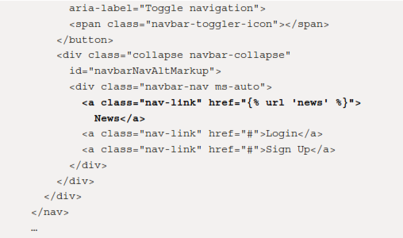
moviereviews/templates/base.html, add the following code in bold:

Slide 17
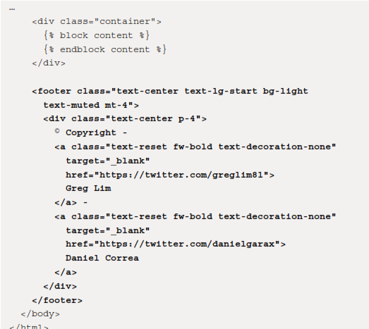
Adding a footer section
In moviereviews/templates/base.html, we will make the following changes in bold:

Slide 18
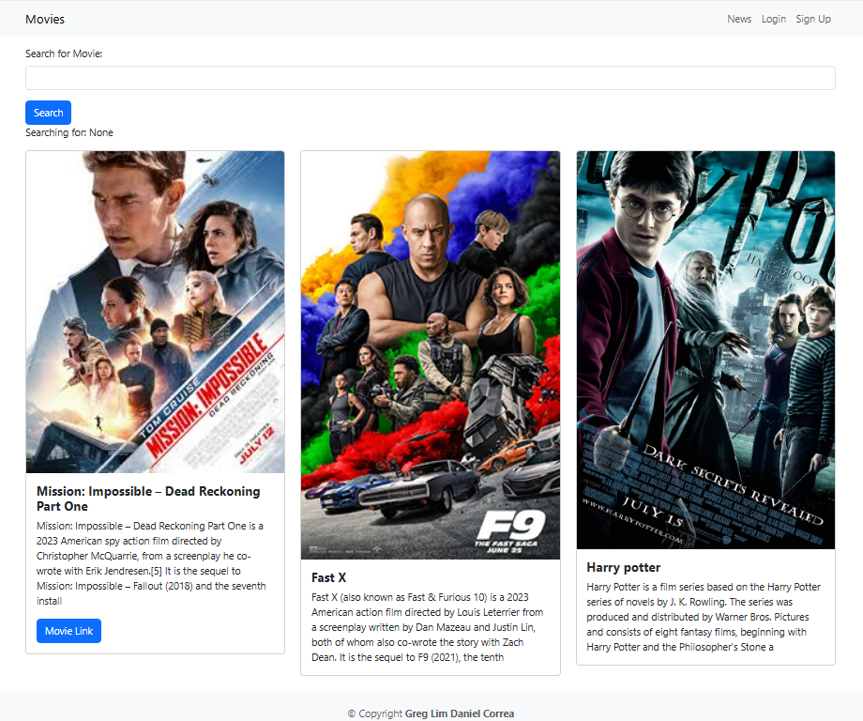

Slide 19

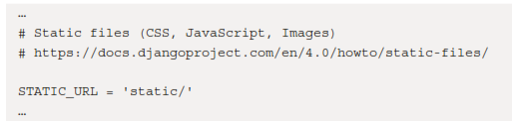
Serving static files
Let's suppose we want to display an image icon for our site.
These are examples of fixed images on the site. These fixed images are static files. They are different from media files that users upload to the site, such as movie images.
In /moviereviews/settings.py, we have a STATIC_URL = '/static/'property. Above the property is a comment, containing a link to documentation on how to use static files?

Slide 20
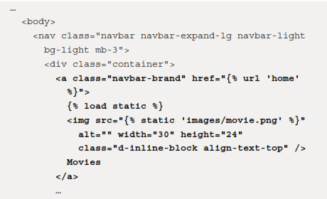
In /moviereviews, create a folder, static. In it, create an images folder to contain the fixed images used on our site.
Bring in an image file (forexample, movie.png) that you want to display on your site into the images folder. In moviereviews/templates/base.html, replace the Movies link with the following:

Slide 21
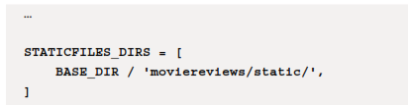
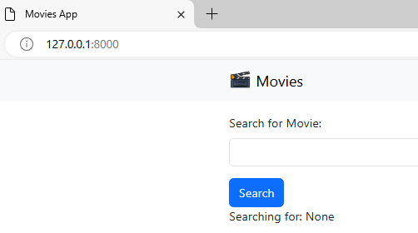
Add at the end of the /moviereviews/settings.py file the following code in bold:
Header with icon

Slide 22
Thank you

